Slide 1
READ ME This template uses the font ‘Space Grotesk’ – be sure to download the font before making edits to the deck. Here’s the link to the ZIP file containing the font. If you cannot access the link above, you can download the font for free via Google Fonts.

Slide 2
ASP.NET Core Backend

Slide 3
ASP.NET Core Web API

Slide 4
Controller-based API
Minimal API

Slide 5
Azure OpenAI SDK

Slide 6
Integration with Blazor frontend

Slide 7
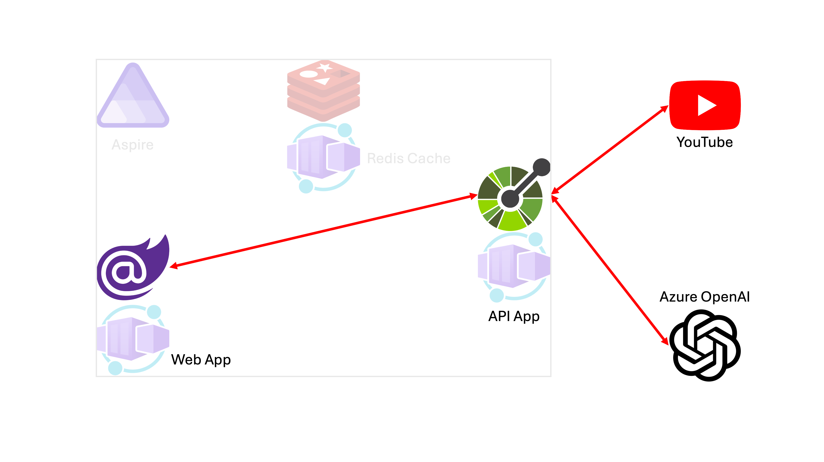

Slide 8
Let’s get started!
https://bit.ly/gh-copilot-lite

